Slide 1
QA EEG pre-processing pipeline
Douwe Horsthuis
CNL
9/23/2022

Slide 2
What is the point of this?
Pre-processing data
The idea is that data is pre-processed as it comes in
This should save time at the end.
This should give insight when there are some people collected
This allows us to see pretty early on if the expected differences are there (if robust)
Quality control on an individual subject level
Is the individual dataset worth using
Overview (Readme file, ERP, Eye tracking, Reaction Time, Time frequency)

Slide 3
Why use this?
Knowing if data problems during collection are unique or happen more often
Knowing if the task is too hard for 1 participant vs multiple
Knowing if the signal is strong / weak
Knowing if the quality of the data is good

Slide 4
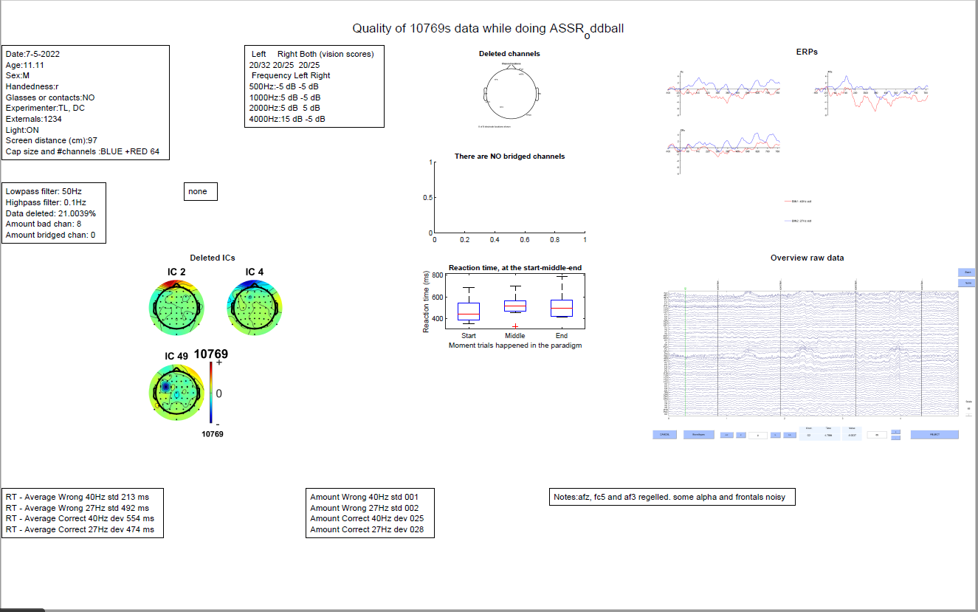
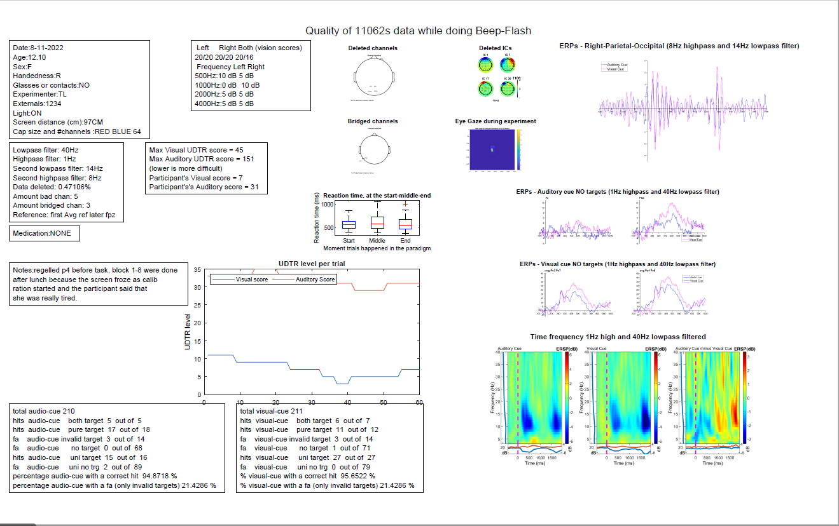
What is unique
Each participant give you an output file
PDF, because the quality of the images are significantly better
Can include whatever is relevant for your study
Pipeline information
Readme file information
Reaction time info
Deleted IC components
Deleted channel location
Bridged channel location
Raw EEG data
ERP(s)
Eye tracking gaze
Time frequency analysis
Paradigm specific info
Notes:
Specifically: The pipeline info uses variable that are also used to set the filter strength etc. Or a calculation of how much data / channels are deleted or how many channels are bridged.
If there are no bridged or deleted cahnnels, the figure is empty as you can see in the top plot. This seemed better then not having a figure at all because that could be confusing.
For both RT, RT related info, and UDTR stuff I use calculations that I make in the pipeline. While this is not something that generalizes to everyones pipeline, it should be easy to plot if one thinks it is relevant.

Slide 5
What can be adapted
Everything
The output file is a full window figure with a subplot of n*m
You can choose the n and m value, so you can choose how to divide your output figure
This allows you to add figures of different sizes
This allows you to use the space however you think is best for your specific data
Most figures are re-loaded after the pipeline is finished, so you can change this to load any figure
The text are note sections that you can place independently of your figure configuration, giving you more freedom
While the source code is integrated in a pipeline you can take the relevant functions and just add them to a different pipeline

Slide 6
Which functions actually add anything unique
[EEG]=readme_to_EEG(EEG,readme_yn,data_path,save_path_indv,subject_list{s});
This function loads the readme file (if it exists)
It looks for predefined words (e.g. medication, age, 500Hz, vision test etc.)
If it finds them; Takes the text related to that word and saves it so it can add this to the end figure
If it doesn’t find them; Prompts user to enter this info manually
Outputs all this text into the end figure
Bridge=eBridge(EEG)
Looks for channels that are bridged
See Alschuler et al. 2013
EDF2Mat/edf_to_fig
Edf_to_fig uses parts of the EDF2Mat function to create ET gaze plot
But also allows you to use ALL EDF files, by merging them
See https://github.com/uzh/edf-converter

